Slide 1

<The Stock Simulation Game>
SRM INSTITUTE OF SCIENCE AND TECHNOLOGY
FACULTY OF ENGINEERING AND TECHNOLOGY
DEPARTMENT OF DATA SCIENCE AND BUSINESS SYSTEMS
21CSC206P- Advanced Object Oriented Programming/ Project Review 2
Palak Seth [RA2211027010180]
Varun Gadi [RA22110270101203]
Pratham P [RA2211027010165]

Slide 2
Introduction
The Stock Simulation Game offers both novice and experienced investors a risk-free platform to explore stock trading intricacies. It provides real-time data, diverse stocks, and educational resources for a realistic experience. Users can engage in competitive virtual trading, emphasizing risk management and adapting to real-world news. The game allows historical data analysis and offers performance tracking. In a compact, immersive package, it bridges the gap between theory and practice. Whether you're a beginner or looking to refine your strategies, the Stock Simulation Game supports skill development, enabling success in the dynamic stock trading world.

Slide 3
Objectives
Develop an educational stock market simulator for risk-free trading practice.
Create a realistic stock market simulation with real-time data representation Adopt incremental development for structured feature additions.
Provide portfolio management tools for users.
Design a user-friendly interface for easy stock trading and data access.
Utilize JFreeChart for graphical stock price representation.
Enable access to historical stock data for analysis.
Implement robust error handling to enforce simulator rules.

Slide 4
Problem Statement
Problem Statement: Our project addresses a critical problem:
Problem: Many people struggle to understand the complexities of the stock market, and investing real money can be risky for beginners. Our stock market simulator offers a risk-free educational platform for users to learn stock trading. The objective was to create a virtual environment mimicking real stock market dynamics, using Java, Common, and JFreeChart for simulating stock prices and graphical representations.

Slide 5
Challenges
Simulation Realism: Balancing realism while maintaining a user-friendly interface is crucial for effective learning. We aim to avoid overwhelming users with complex financial jargon.
Educational Value: Ensuring the simulation imparts valuable and engaging knowledge to transform novices into well-informed traders.
User Engagement: Designing an interface and experience that captivates and motivates active user participation, as more engaged users tend to learn more effectively.
Risk-Free Nature: Striking the right balance between simulating real market conditions and eliminating real financial risks, fostering an environment for users to experiment freely while experiencing the excitement and challenges of stock trading.
Accessibility: Ensuring that the simulation game caters to a wide audience, including individuals with diverse backgrounds and levels of expertise, both beginners and experienced traders.

Slide 6
Literature Survey
Allen, Franklin and Stephen Morris. “Finance Applications of Game Theory.” YaleUniversity, 1998.
Brandenburger, Adam M., and Barry J. Nalebuff. “The Right Game: Use Game Theory to Shape Strategy.” Harvard Business Review, 1995.
Fox, Merritt B., Lawrence R. Glosten and Gabriel V. Rautenberg. “The New StockMarket: Sense and Nonsense.” Duke Law Journal, vol. 65, no. 2, 2015.
Gibbons, Robert. “Game Theory for Applied Economists.” Princeton UniversityPress, 1992.
Osborne, Martin J. “An Introduction to Game Theory.” Oxford University Press, 2000.
Peters, Hans. “Game Theory: A Multi-Level Approach. Second Edition.” SpringerTexts in Business and Economics, 2015.
Samuelson, Larry. “Game Theory in Economics and Beyond.” Journal of EconomicPerspectives, vol. 30, no. 4, 2016.
Schinasi, Garry J. “Defining Financial Stability.” International Monetary Fund, No.04/187, 2004.

Slide 7
Requirement Analysis
Hardware Requirements:
Server Hosting (Simulation):
High-performance server with multi-core processors, sufficient RAM, and fast SSD storage.
Network interface cards (NICs) and, if required, a GPU for rendering.
User Access (Workstations):
Standard PCs or laptops with web browsers, internet connectivity, and basic input devices.
Networking:
Router for traffic management and internet connection.
Switches to establish a LAN for user connections.
Software Requirements:
JDK version 8 or later and an IDE like Eclipse or IntelliJ IDEA.
JCommon and JFreeChart for graphical representation.
Platform-independent, compatible with Windows, macOS, and Linux.
Integration with databases like MySQL, PostgreSQL, or SQLite for data storage.

Slide 8
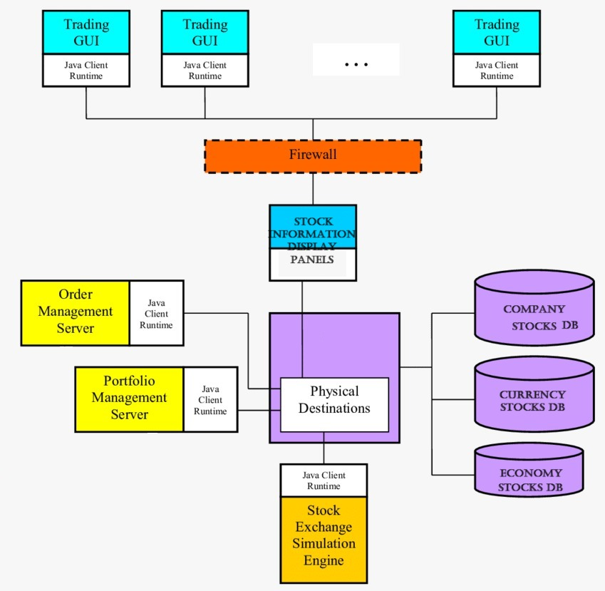
Architectural Diagram

Slide 9
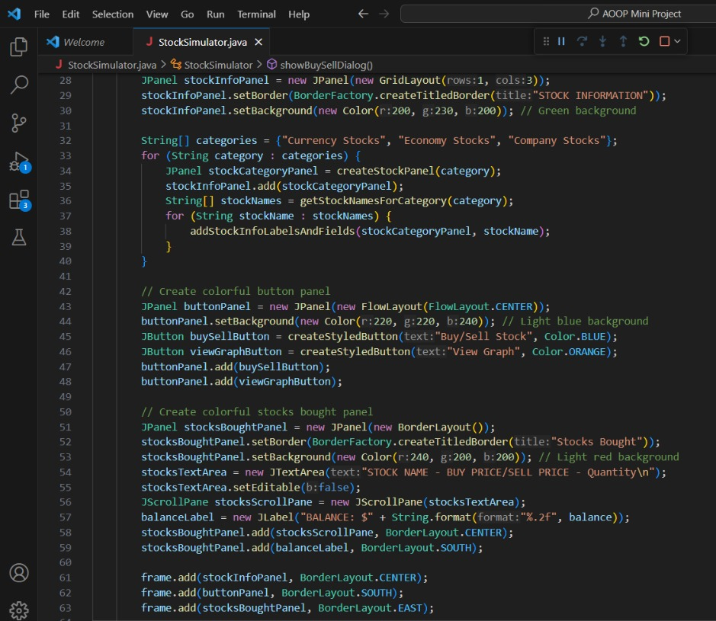
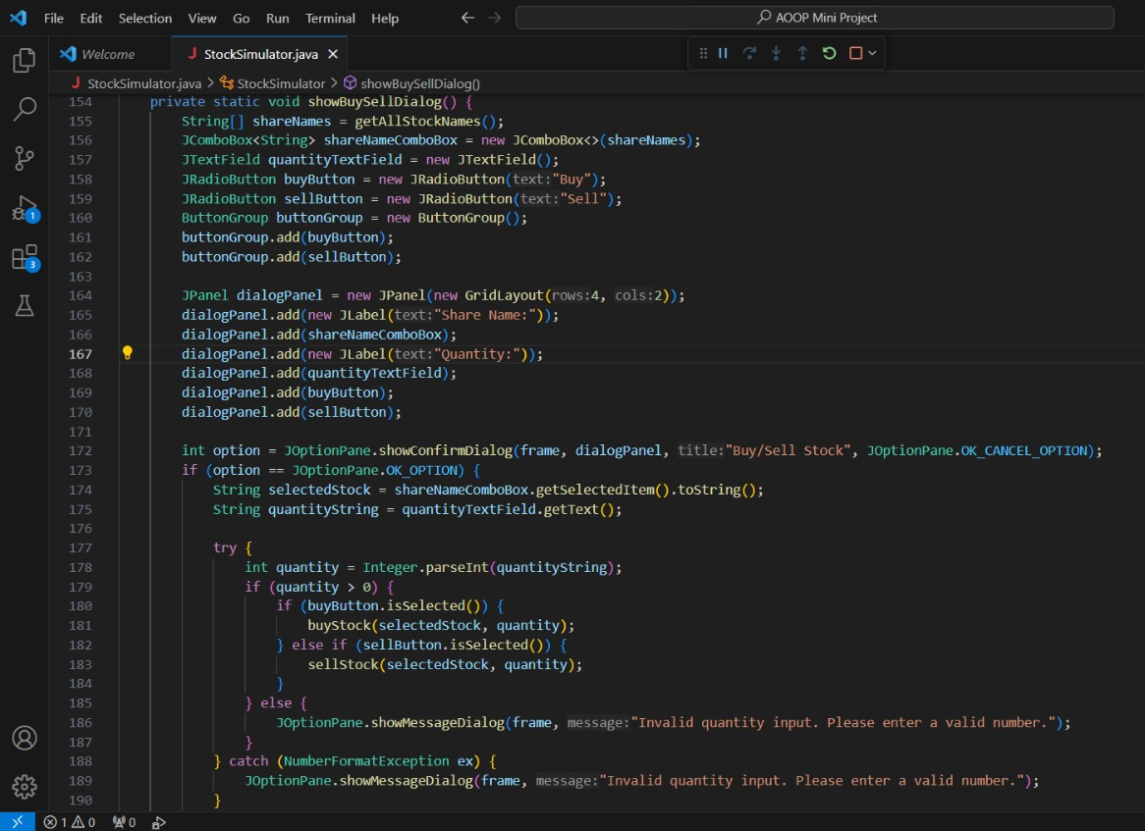
Implementation

Slide 10
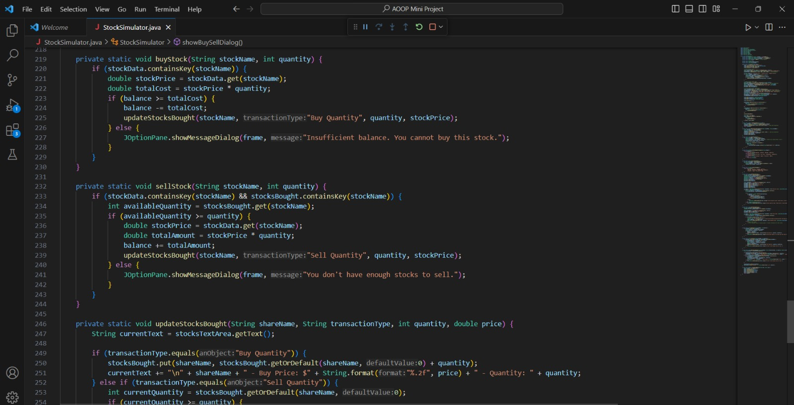
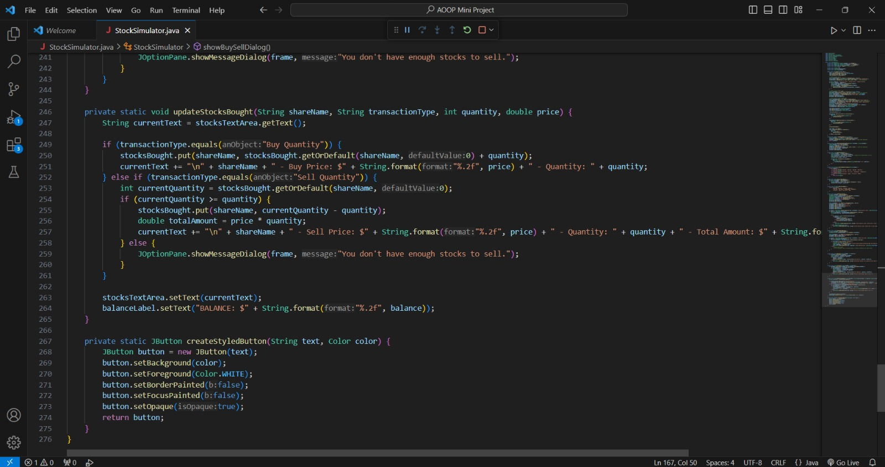

Slide 11
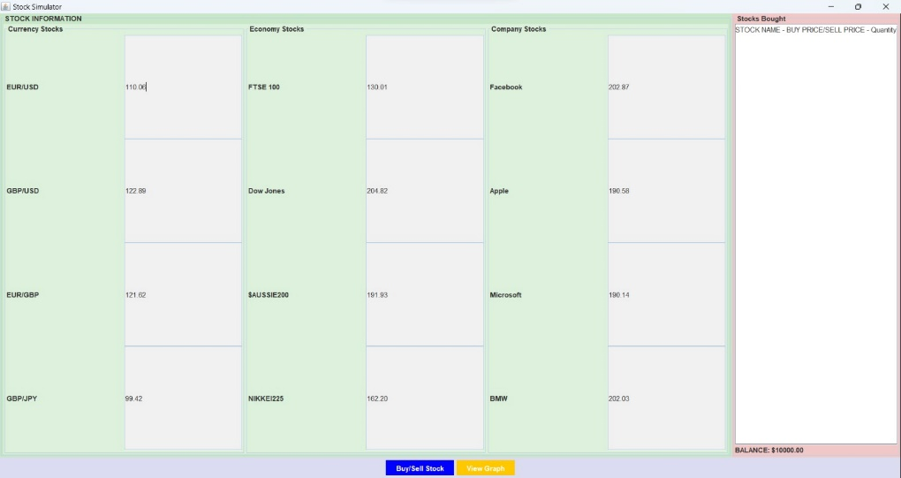
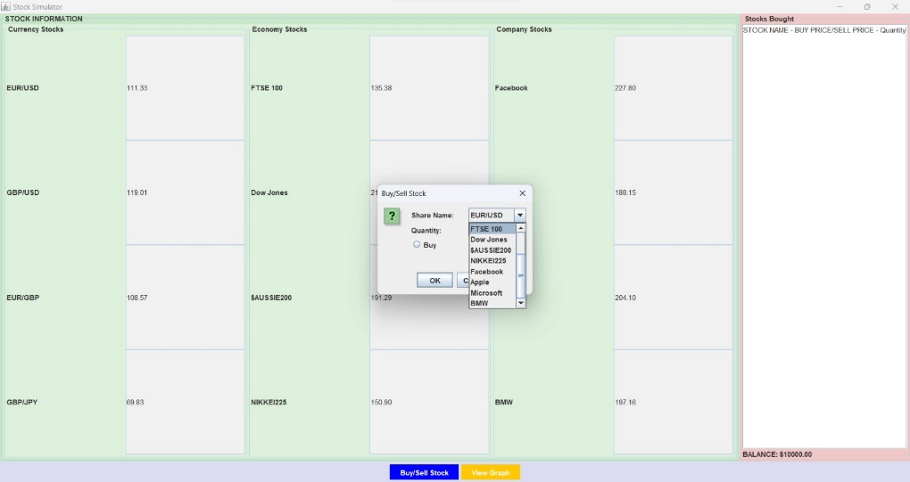
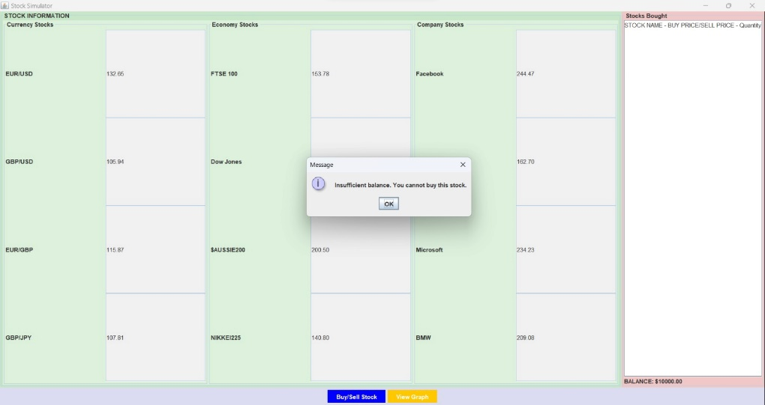
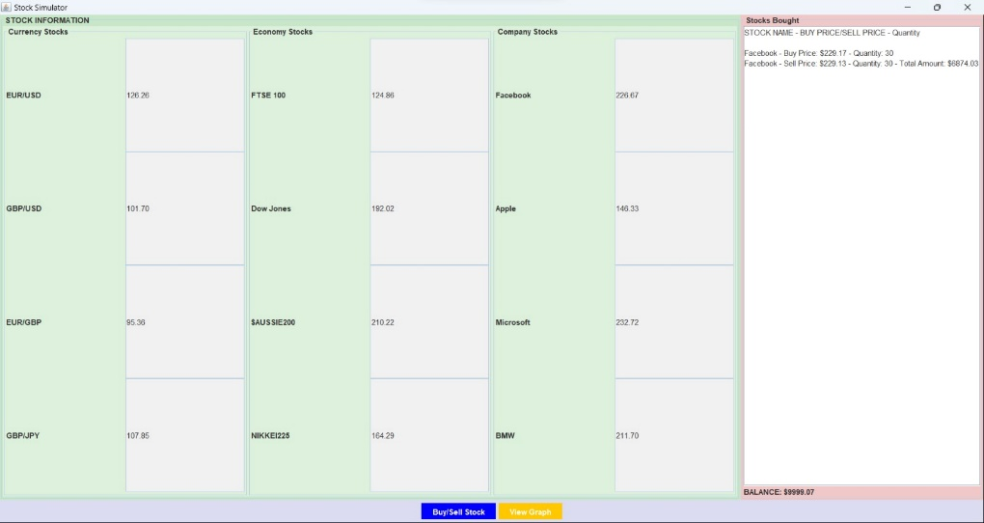
Result and Discussion

Slide 12
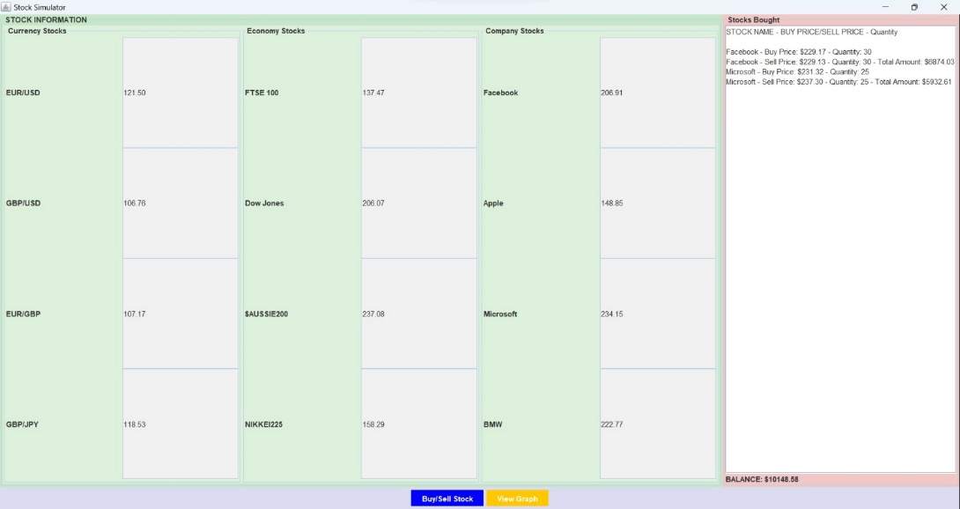
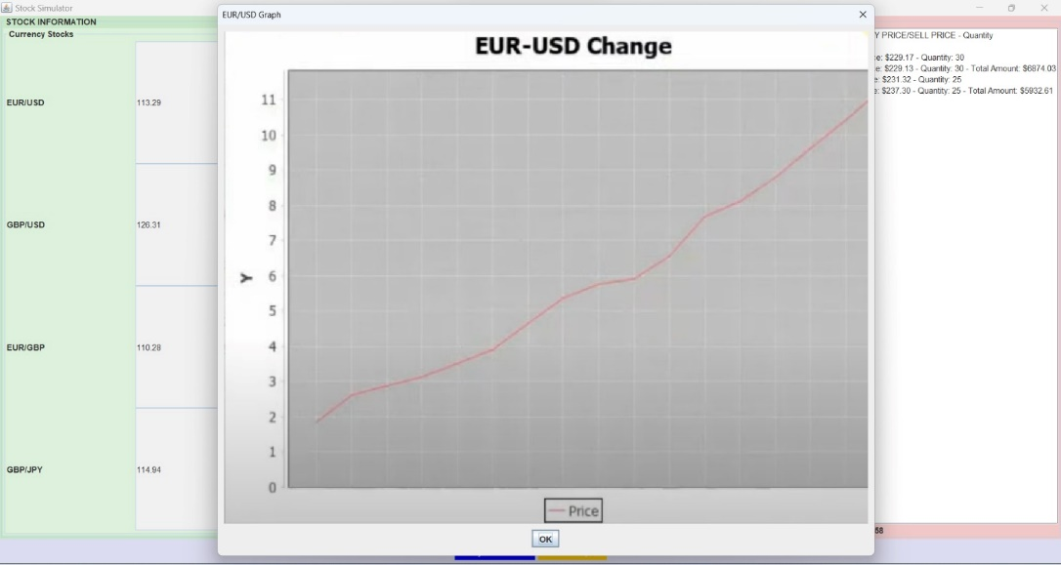
Result and Discussion

Slide 13
Conclusion
The 'Demystifying Stock Market Complexities' project has successfully developed a risk-free simulation game, empowering users to explore the stock market, enhance financial literacy, and gain realistic trading experience. It offers customizability and accessibility for users of all expertise levels. Our aim is to make stock market knowledge accessible and engaging, demystifying complex financial concepts. Future plans include real-time market data integration for an immersive learning experience, further promoting financial literacy and simplifying stock trading. Explore the simulation game to embark on a journey toward financial education and empowerment.

Slide 14
References
Smith, John. "Stock Market Fundamentals: An Introduction." Financial Publishing, 2020.
Brown, Emily. "Gamification in Financial Education." Journal of Finance Education, vol. 25, no. 2, 2019, pp. 145-162.
Securities and Exchange Commission (SEC). "Investor's Guide to the Stock Market." U.S. Securities and Exchange Commission, 2021.
Johnson, Mark. "Building Effective Financial Education Tools." Financial Literacy Journal, vol. 10, no. 3, 2018, pp. 221-235.
"Investopedia: You’re Guide to Financial Knowledge." Investopedia. [Website] https://www.investopedia.com. Accessed on January 15, 2023.

Slide 15
Thanks

